Slide 1
Long Distance Carpooling Application for Hokies
By: Michael Richter, Charlie Nguyen, Paul Blackburn, and Angela Mattamana

Slide 2
Introduction - Pain Points for Hokies
Many students don’t have a vehicle on campus they could use to get home
Uber is expensive and not for long distance
Airfare is expensive and students have to find a way to get to Roanoke Airport
Facebook Pages (Virginia Tech Carpool Group) have spam with people selling items and scammers
Physical rideshare boards are no longer prominent
Parents may live too far away for a round-trip same day pick up
Unsafe drivers offering rides
Notes:
Paul
Scammers
Bad drivers

Slide 3
Introduction - What Our App Does
Drivers and Riders interface with each other through our application.
Our application improves reliability and safety when riding with strangers.
Drivers create trips that riders can join for a fee.
We ensure the application has good actors by banning drivers and riders with low scores.
This allows drivers to be able to charge more because they are offering a premium service.
Notes:
Angela

Slide 4
Appealing Features - Algorithms
For Calculating Rider and Driver Scores
public float calculateScore (Feedback feedback, User user) {
int score = ((user.rating * user.numberFeedbacks) + feedback.rating) / (user.numberFeedbacks + 1)
user.rating = score
user.numberFeedbacks += 1
IF feedback.comments is negative THEN
send comments to hr
ENDIF
RETURN user.rating
}
Notes:
Angela

Slide 5
Driver can Choose Riders for their Trip that have Expressed Interest
public List<Rider> swipeRiders(List<Riders> riders)
{
ArrayList<Rider> chosen = new ArrayList<Rider>
FOR each rider in riders
IF rider.swipe is right THEN
chosen.add(rider)
ELSE IF rider.swipe is left THEN
status = false
ENDIF
ENDFOR
FOR each rider in chosen
Send notification to rider that they have been chosen
ENDFOR
RETURN chosen
}
Notes:
Michael

Slide 6
Drivers Must Sign Up with Valid License and Insurance Policy
public boolean driverSignUp (Driver driver, Picture license, Picture insurance) {
parse LicenseNumber and Sex from license
parse Insurance Policy Number from insurance
IF LicenseNumber is valid THEN
calculate driver.safetyScore from license
IF driver.safetyScore is low THEN
RETURN false
ENDIF
ELSE
RETURN false
ENDIF
IF insurance is valid THEN
add driver to allDrivers in system
add driver to allUsers in system
RETURN true
ELSE
RETURN false
ENDIF
}
Notes:
Angela

Slide 7
Driver Receives Payment Upon Dropping Off Rider
public boolean paymentReceived(Payment payment){
Checks map to see destination
IF driver reaches riders destination THEN
payment is taken from rider’s chosen payment method and deposited to driver
RETURN true
ELSE
Driver hasn’t reached destination and does not receive payment
RETURN false
ENDIF
}
Notes:
Chuck

Slide 8
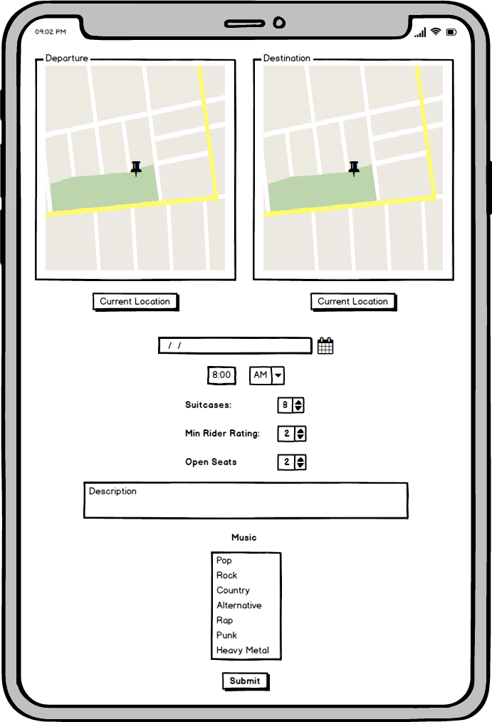
Appealing Features - UI
Drivers can Register Trip into Database
Notes:
Paul

Slide 9
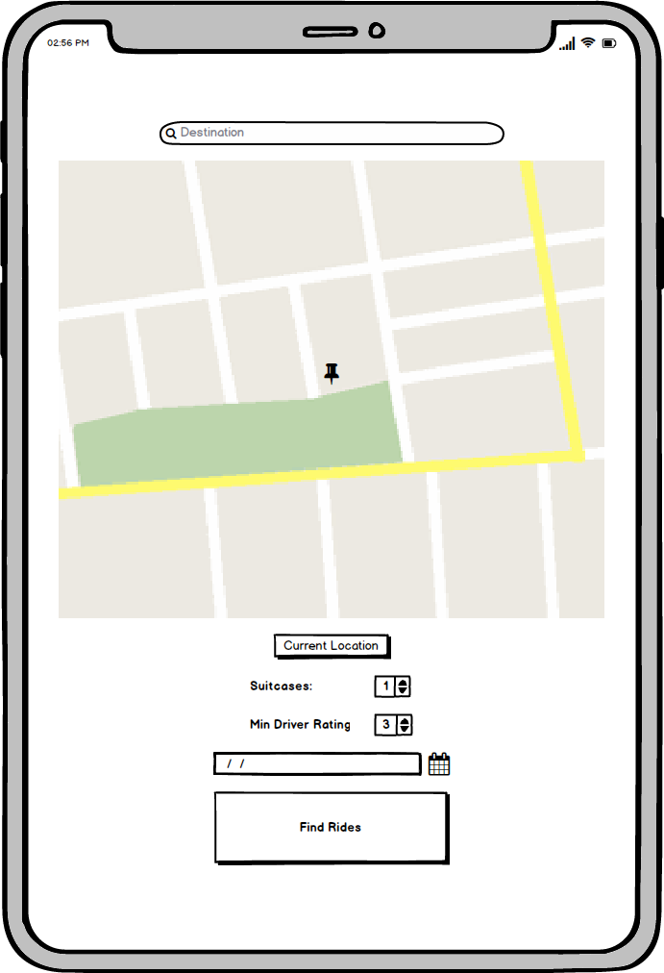
Riders can Search for Trips Based on Proximity to Final Destination and also Purchase Luggage Space in the Ride
Notes:
Paul

Slide 10
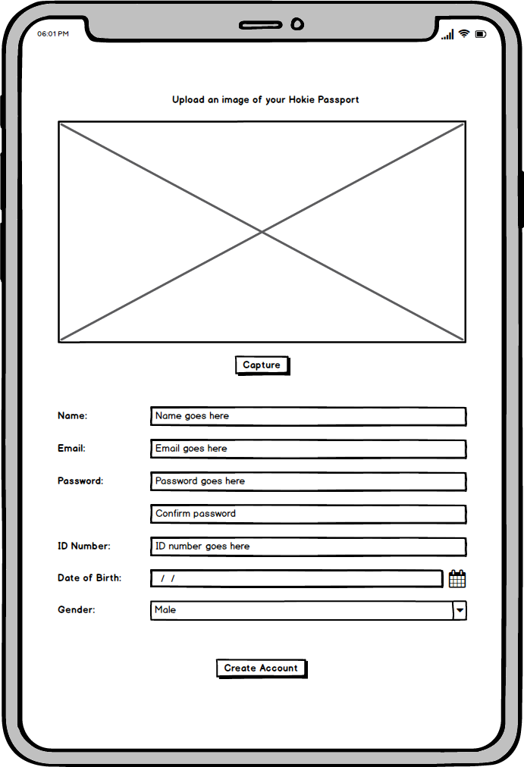
Potential New Riders can Sign Up Using their Hokie Passport
Notes:
Paul

Slide 11
Challenges and solutions
Calculating speed
Can’t calculate straight line distance on curvy roads
iPhone has speed sensor that we can use
Interfacing with existing VT systems to ensure users are Virginia Tech students
Work with Virginia Tech to gain read-only access of student database
Cohesive class structure
General classes that ensure nothing is repetitive and will work together
Liability
Terms of service that waives any liability
Notes:
Michael

Slide 12
Lessons Learnt
Git were very helpful in managing our workflow
Ensured we submitted each stage of the project to the customer (Canvas) on time.
Team Work
Different processes that go into creating a software
Step-by-step process ensures that product is created and delivered in a timely manner
Notes:
Angela

Slide 13
Summary

